Slide 1

The Middlefield Way
11th January 2022

Slide 2
Our ‘Values’
Values are the things that we believe are very important.
Values are the attitudes that we want all children and staff to show.
Values are the ways that we want all children and staff to act.
Values are the behaviours that we should all try to demonstrate.
The values of our school are what makes us special and unique…

Slide 3
The School Council
The school council have worked with Mr Potter and Mrs Evans to come up with 6 of the most important values that we believe ALL members of our school community should try to live and work by…
Our Year 6 Council members then helped to explain what each of these values are…

Slide 4

We have hopes and dreams

Slide 5

We do not give up and always try our best

Slide 6

We try to understand other people’s feelings and points of view

Slide 7

We are caring and look after each other

Slide 8

We make the right choices and find the good in all situations

Slide 9

We can bounce back from disappointment and cope with problems

Slide 10
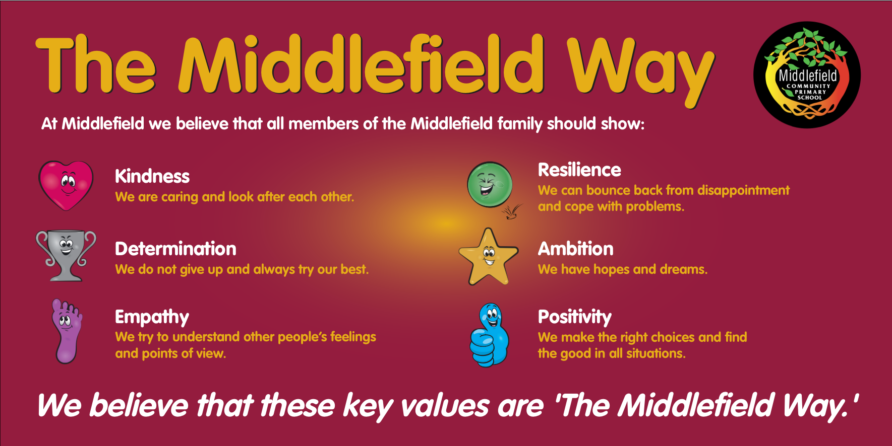
When we put all of these values together, we get:

Slide 11
How do we show the Middlefield Way?
We show this EVERY day by:
The way we behave!
The way we treat each other!
The way we talk to each other!
The way we work!

Slide 12
The reason we have 6 values is so that we can focus upon 1 key value every half-term.
We will talk about that value at each assembly on Monday morning.
You will also see lots of posters and signs around school reminding us of our values.
The first of our key values for this half-term will be…

Slide 14
Thank you for listening! Have a Great Day!

